Slide 1
Analyzing NFL Draft Patterns Using Network Science
Team Number 2:
Julia Arroyo
Josh Harkness
Alex Gallimore
Presentation Date: 11/20/2019

Slide 2
Purpose
Inform the audience of existing trends in the NFL Draft
Predict a college player’s success based on these trends
Three perspectives: player, professional coach, college coach
Notes:
JOSH Talk about motivation

Slide 3
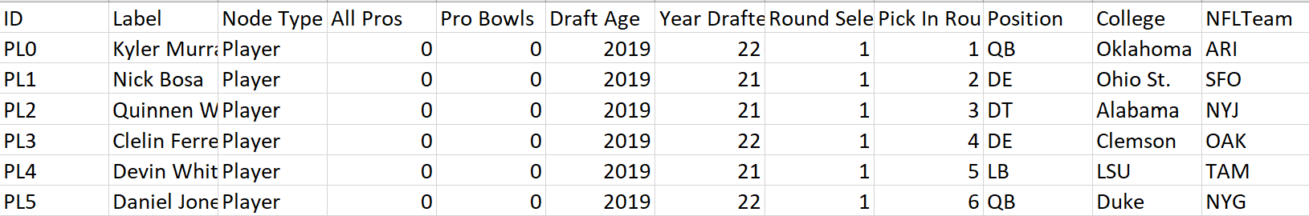
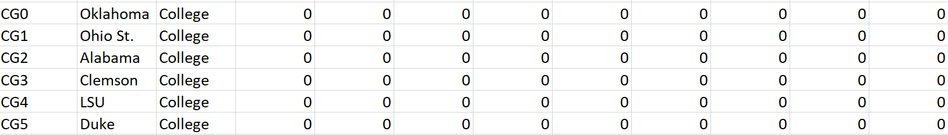
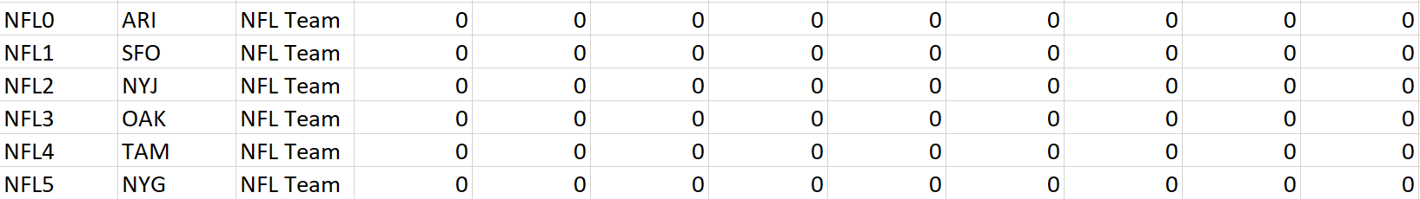
Data Source
pro-football-reference.com
Web scraping using Python
Converting data to CSVs
Notes:
JOSH We chose pro-football-reference as our data source. We originally had a database available to us from Kaggle, but after two weeks, they took down their data. Fortunately, we saw the researcher on Kaggle used the pro-football-reference site to obtain their information, so we created a python project that scraped and wrote our information into both CSVs and html/javascript.
The data consisted of three node types; a player, college, or NFL team. Our analyses focused around draft information, so the only information obtained was the year and round a player was drafted and their position. The college and team a player went to were only provided to make our graphs easier to make in Tableau.

Slide 4
Data
13445 players who have been drafted since 1974
37 NFL teams
466 colleges
Player characteristics: position, draft age, All-Pro selections, Pro-Bowl selections, game stats
Notes:
JOSH- We chose to pull our data from 1974 and beyond because the military ended their mandatory draft in 1973 and we wanted to remove the possibility of a highly talented player being removed from a program to serve.
The NFL only consists of 32 teams after the Panthers and Jaguars joined in 1995, but the 37 shown in the slide are due to NFL teams moving between cities. In our analyses, we merged NFL teams with their past cities.
We limited the attributes to the above due to the difficulty involved with merging players’ physical attributes with the attributes provided by our source. Not only would we have to find another source, but we’d have to then find a key to merge the data on that’s more unique than the combination of name and college.

Slide 5
Network Structure
13943 nodes and 26890 edges
Tripartite graph
Player 1
NFL Team1
College 1
Player 2
NFL Team 2
College 2
Player 3
NFL Team 3
College 3
Player 4
NFL Team 4
Notes:
JULIA

Slide 6

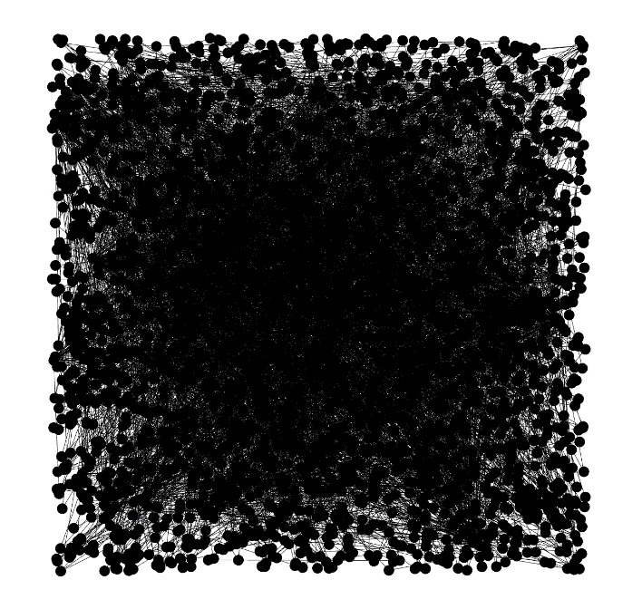
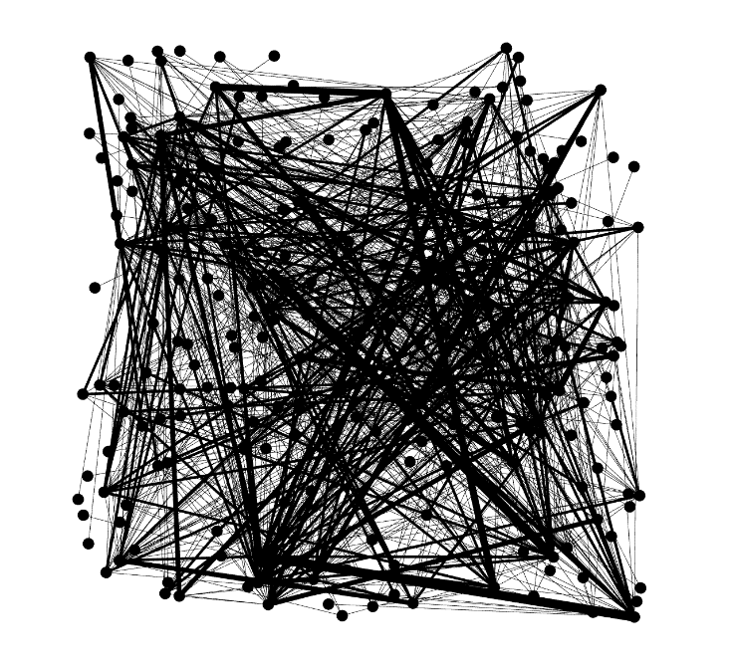
Initial Network
Original
Awarded Players
MultiMode Networks Projection
Nodes: 13943
Edges: 26890
Nodes: 2756
Edges: 5032
Nodes: 240
Edges: 1024
Notes:
JULIA

Slide 7
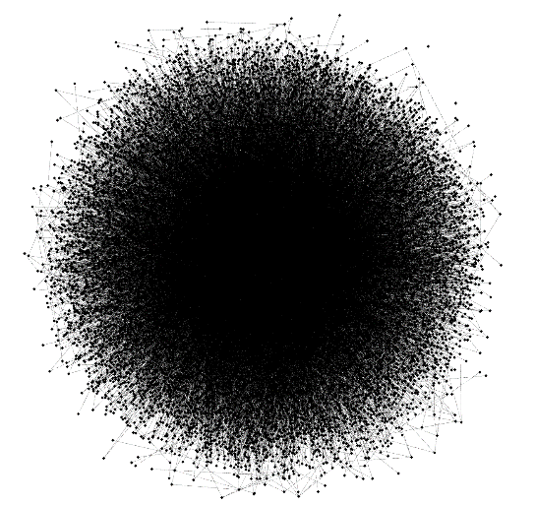
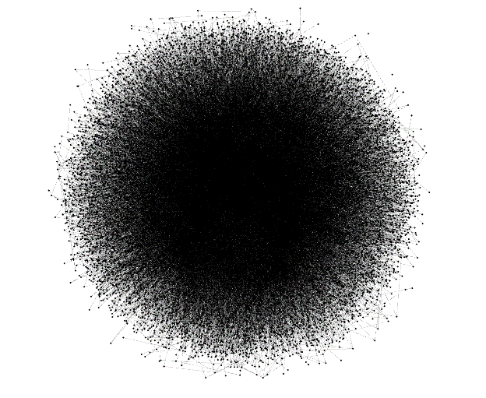
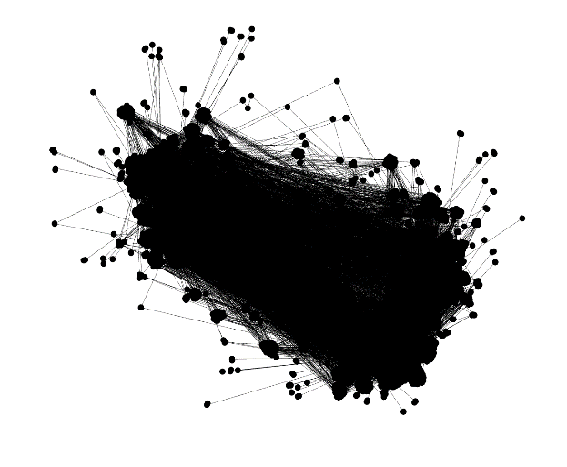
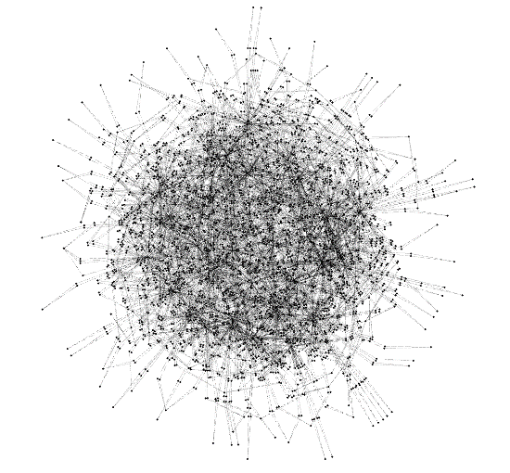
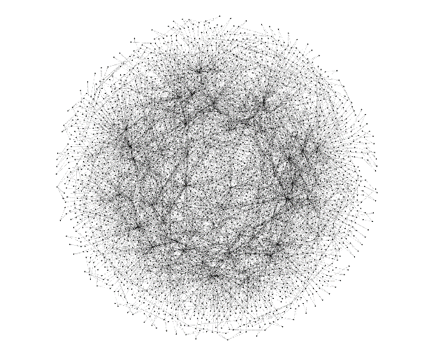
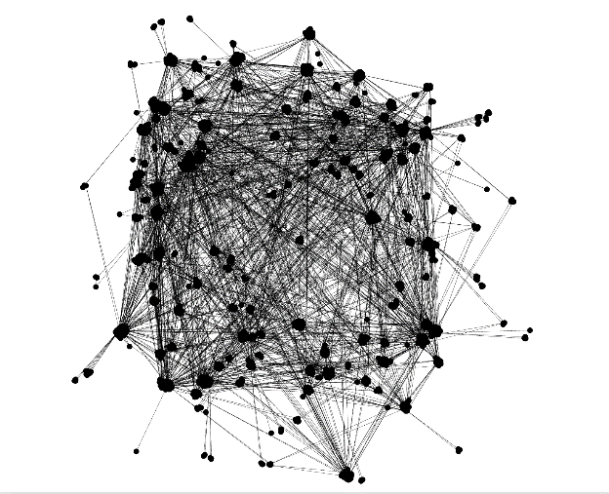
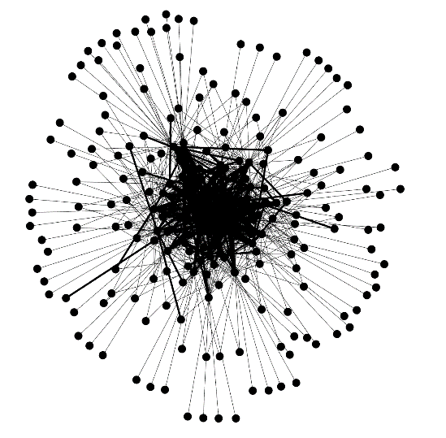
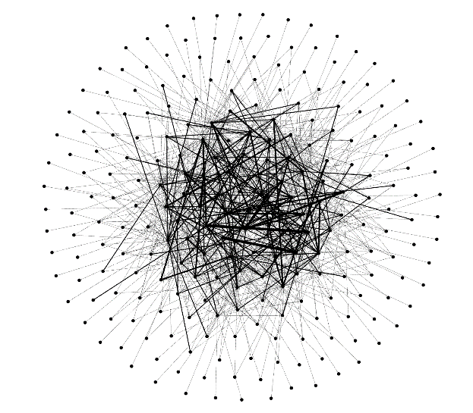
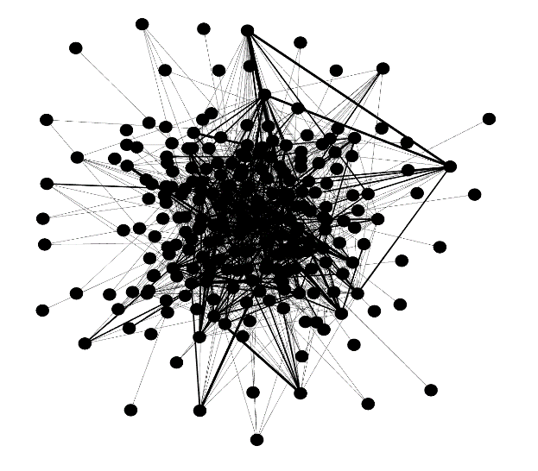
Layout Algorithms
 | Yifan Hu | Fruchterman Reingold | Open Ord
Original
Awarded Players
Multi-Mode
Notes:
ALEX

Slide 8
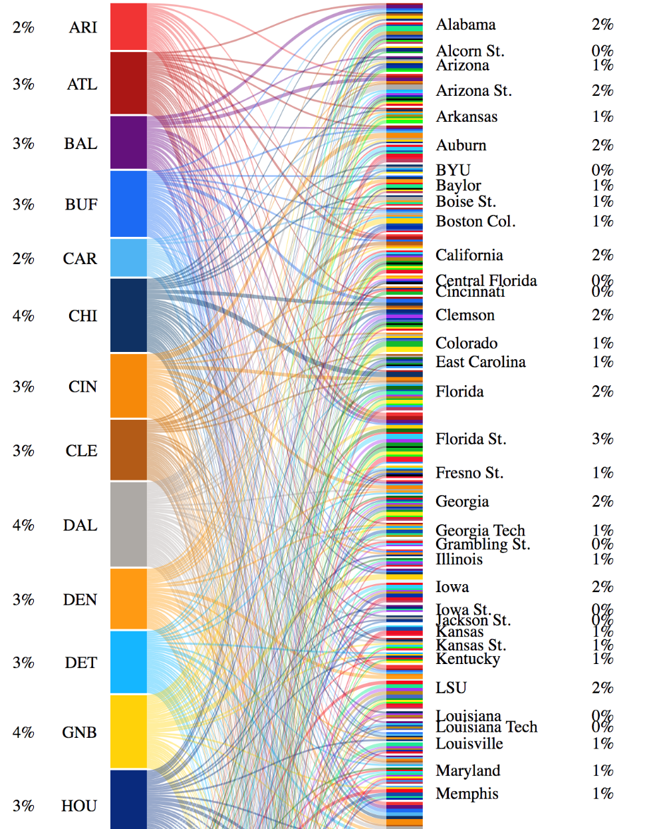
Bipartite Graph
NFL Team
Colleges
http://youthful-aryabhata-307740.netlify.com/
Notes:
JOSH
Homophily- could not see any apparent homophily related to locations. Homophily appears because NFL teams like to draft from specific colleges.

Slide 9
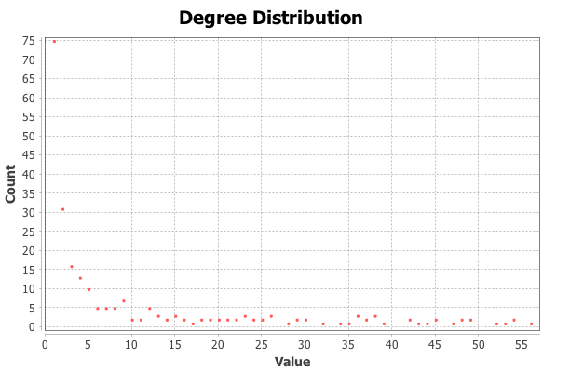
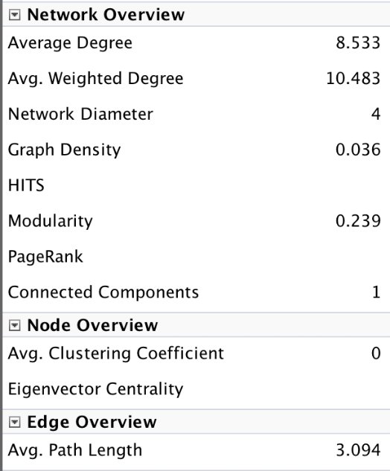
Network Stats
9 communities
Notes:
JULIA
Weighted Degree Distribution- about 76 have a weighted degree of 1. Looking at the data laboratory shows that this is all colleges because a lot of colleges have just one player going to a NFL Team. The higher degrees are typically given to NFL teams because they have a lot of players from different teams joining them.
Betweenness centrality- all low. NFL teams have higher ones because they act as bridges between colleges but colleges don’t act as bridges as much. Looking at the data laboratory shows that all the values with the betweenness centrality at 0 are colleges. The higher ones are all pretty much NFL Teams.
Closeness Centrality- all fall in range of about .3 to .5 because to get to the furthest node from it in the network probably requires just going through a hub or two (no nodes are that far from it in the network), (average distances from a given starting node to the furthest node from it in the network) (lower value means farther apart, higher value means closer together)
Avg. clustering coefficient: 0 because no NFL Teams directly connect with other NFL teams and no colleges connect directly to other colleges. Each college node has neighbors which are NFL team nodes. These NFL team nodes cannot directly connect to one another. The same is true for the other way around.
Density is low because out of the amount of possible connections, the actual amount of connections are low.
Modularity report indicates 9 communities but since the value is low, the connections between nodes in each module is low. Each community seems to represent a few NFL teams and a few colleges that share a lot of the same players, so the weighted degrees are high.

Slide 10
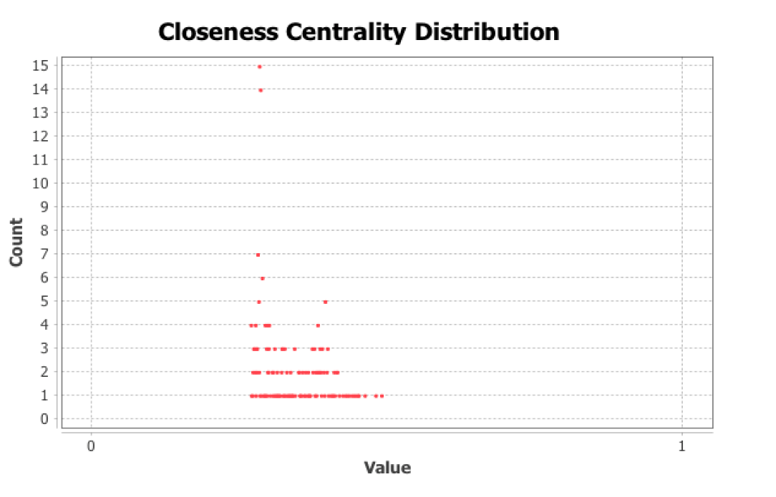
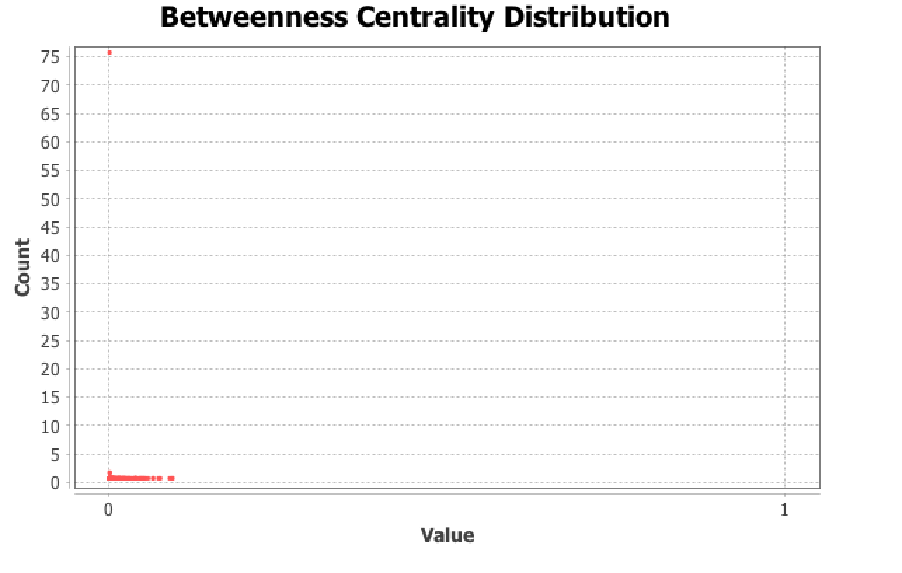
Network Stats
Notes:
JULIA
Weighted degree
Power law

Slide 11
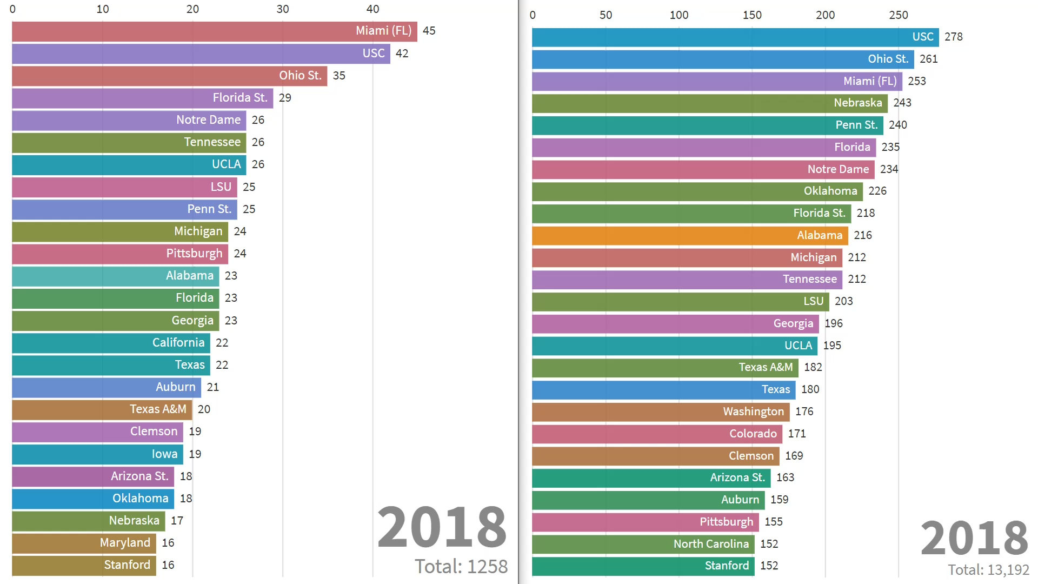
Top 25 Colleges by Year
BarChartNetworkGrowth.mp420 MB MPEG 4 Video— Click to download
Notes:
ALEX

Slide 12
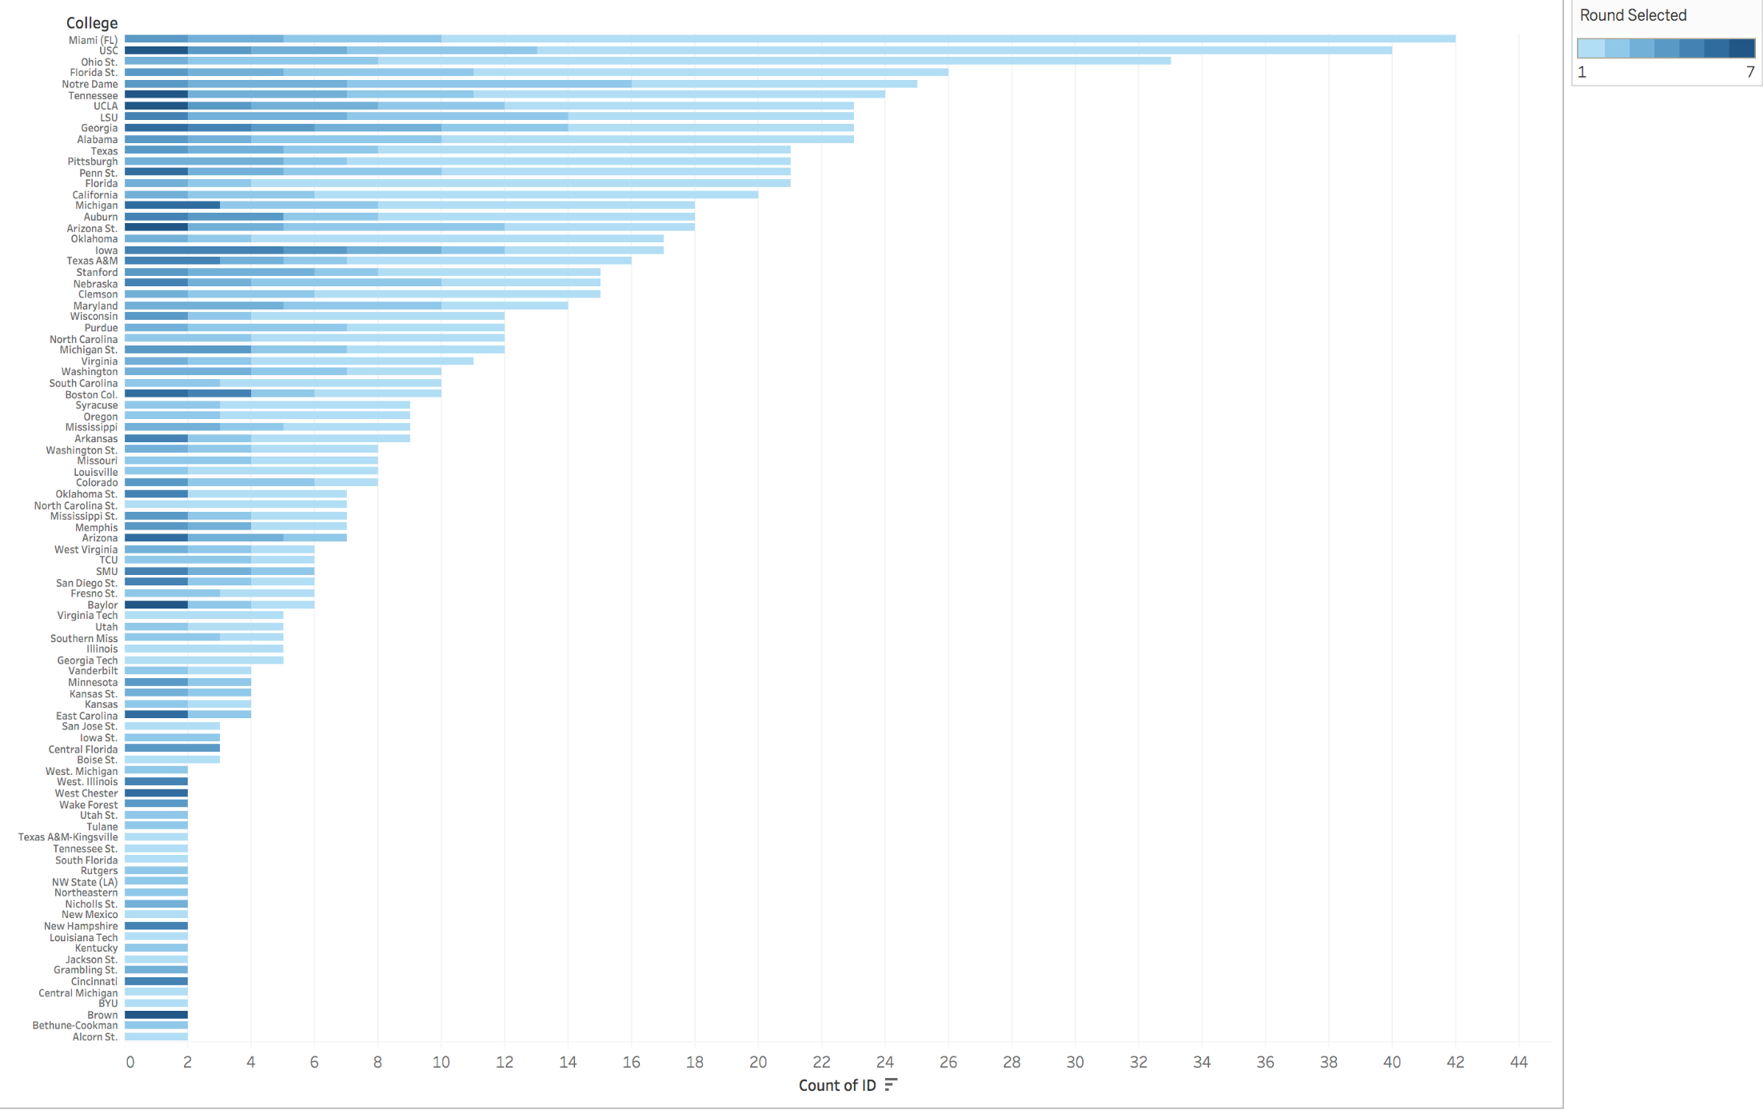
Awarded Players by Colleges
Notes:
ALEX

Slide 13
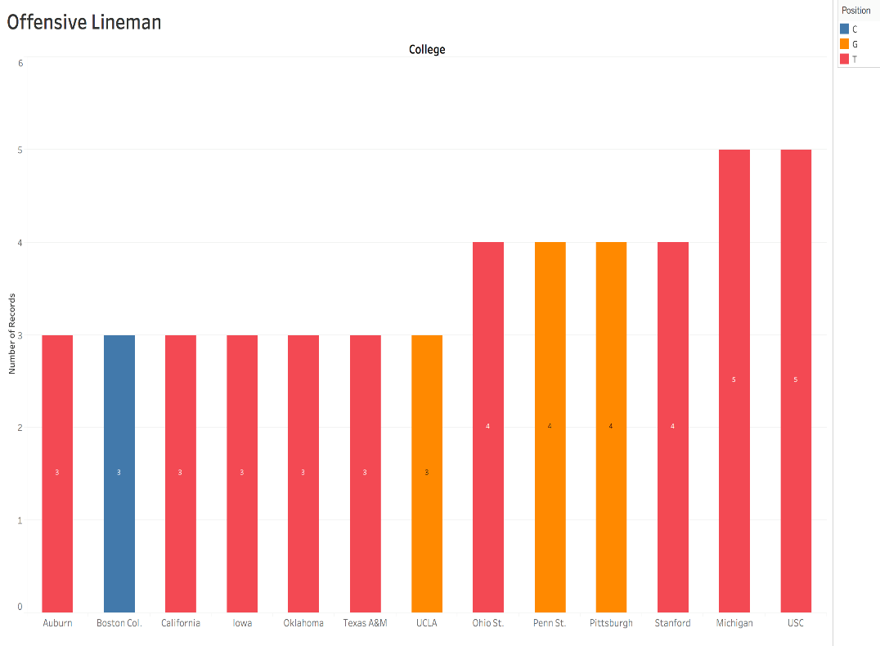
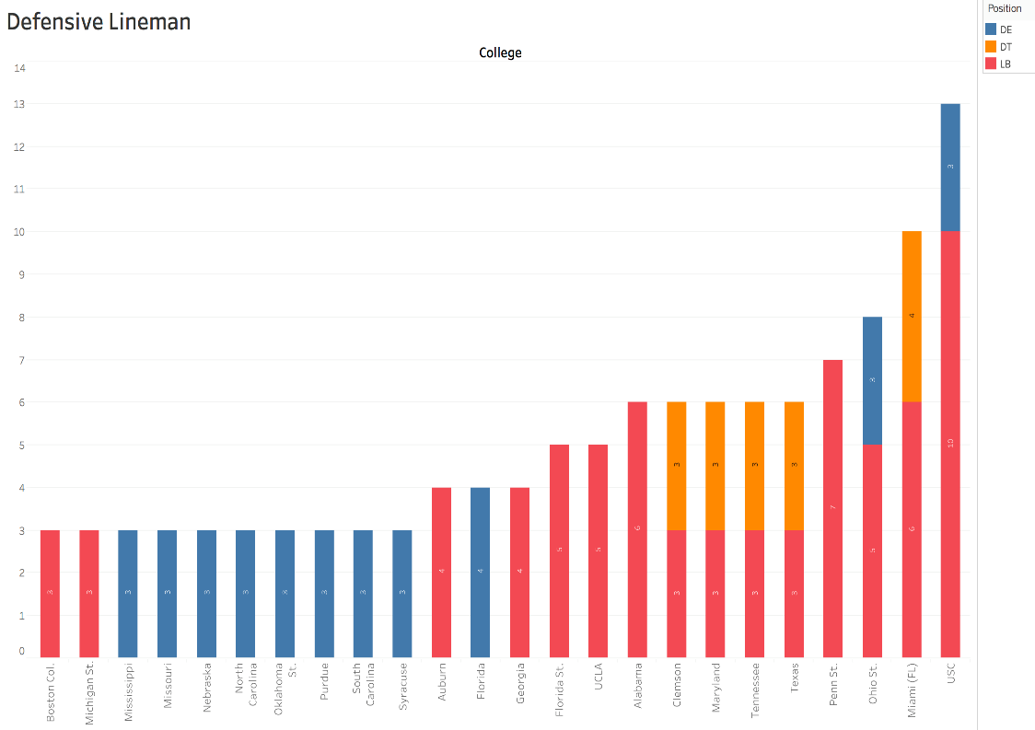
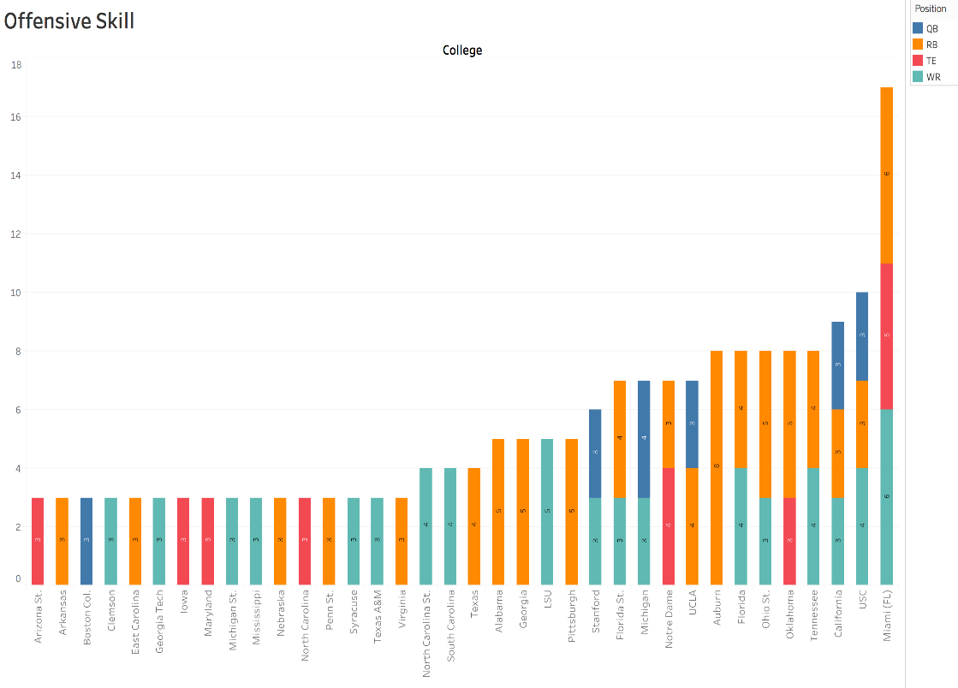
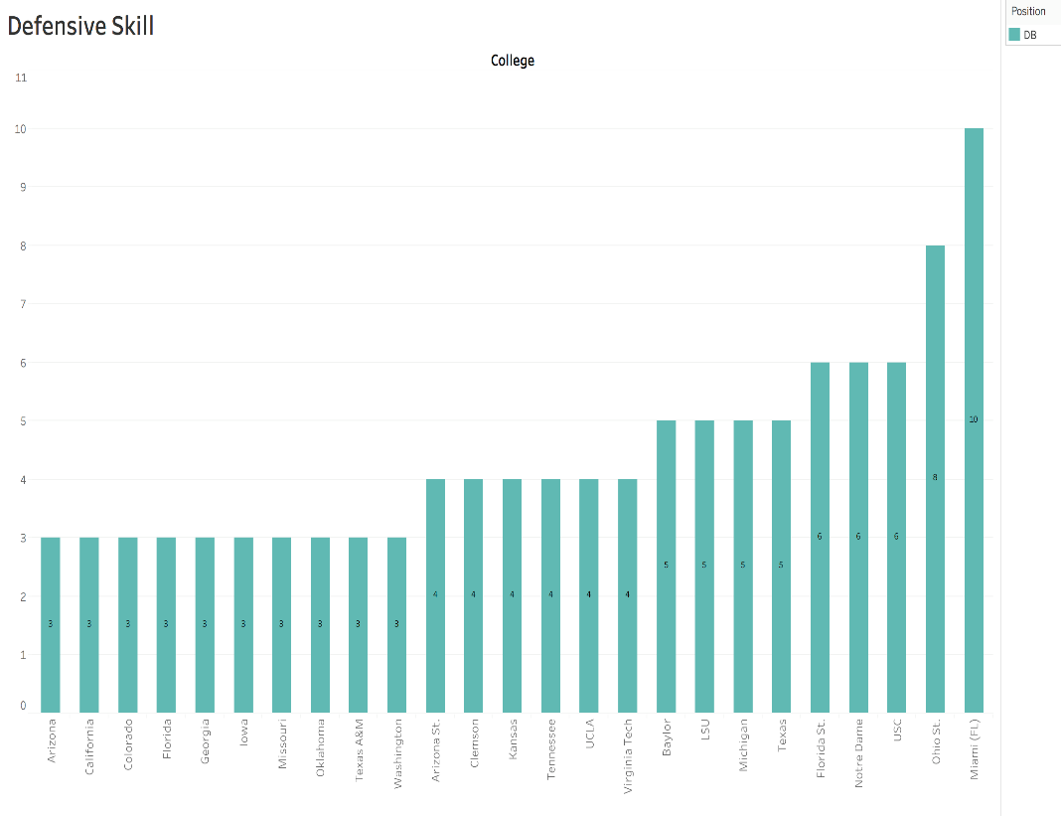
Notes:
JOSH
C: Center, T: Tackle, G:Guard, DE: Defensive End, DT: Defensive Tackle, LB: LineBacker, QB: QuarterBack, RB: Running Back, TE: Tight End, WR: Wide Receiver, DB: Defensive Back
1st chart: Offensive Lineman colleges only produce one type. Center only comes up for Boston College
2nd chart:
Overall Trends:
Miami is the top for defensive lineman, offensive skill and defensive skill but do not appear for offensive lineman.
Schools less known for football show up on these charts such as Washington and Purdue.

Slide 14
Results
Bianconi-Barabási Model with Scale Free Property
College Coaches
High School Players
Professional coaches
Notes:
Scale-free network- JULIA
Ratios- ALEX
Perspectives: JOSH

Slide 15
Final Contemplation
Relevant Data:
Player characteristics (Homophily)
i.e. geographical data, height, weight
High School ratings
NFL Combine Data (physical & cognitive test results)
Career Data
i.e. injury, stats
Workload Distribution
Notes:
JULIA- The final slide should be your contemplation about the project such as: other data that could have been added to make your study more relevant, the difficulty in dividing the workload between team members, data preparation, etc

Slide 16
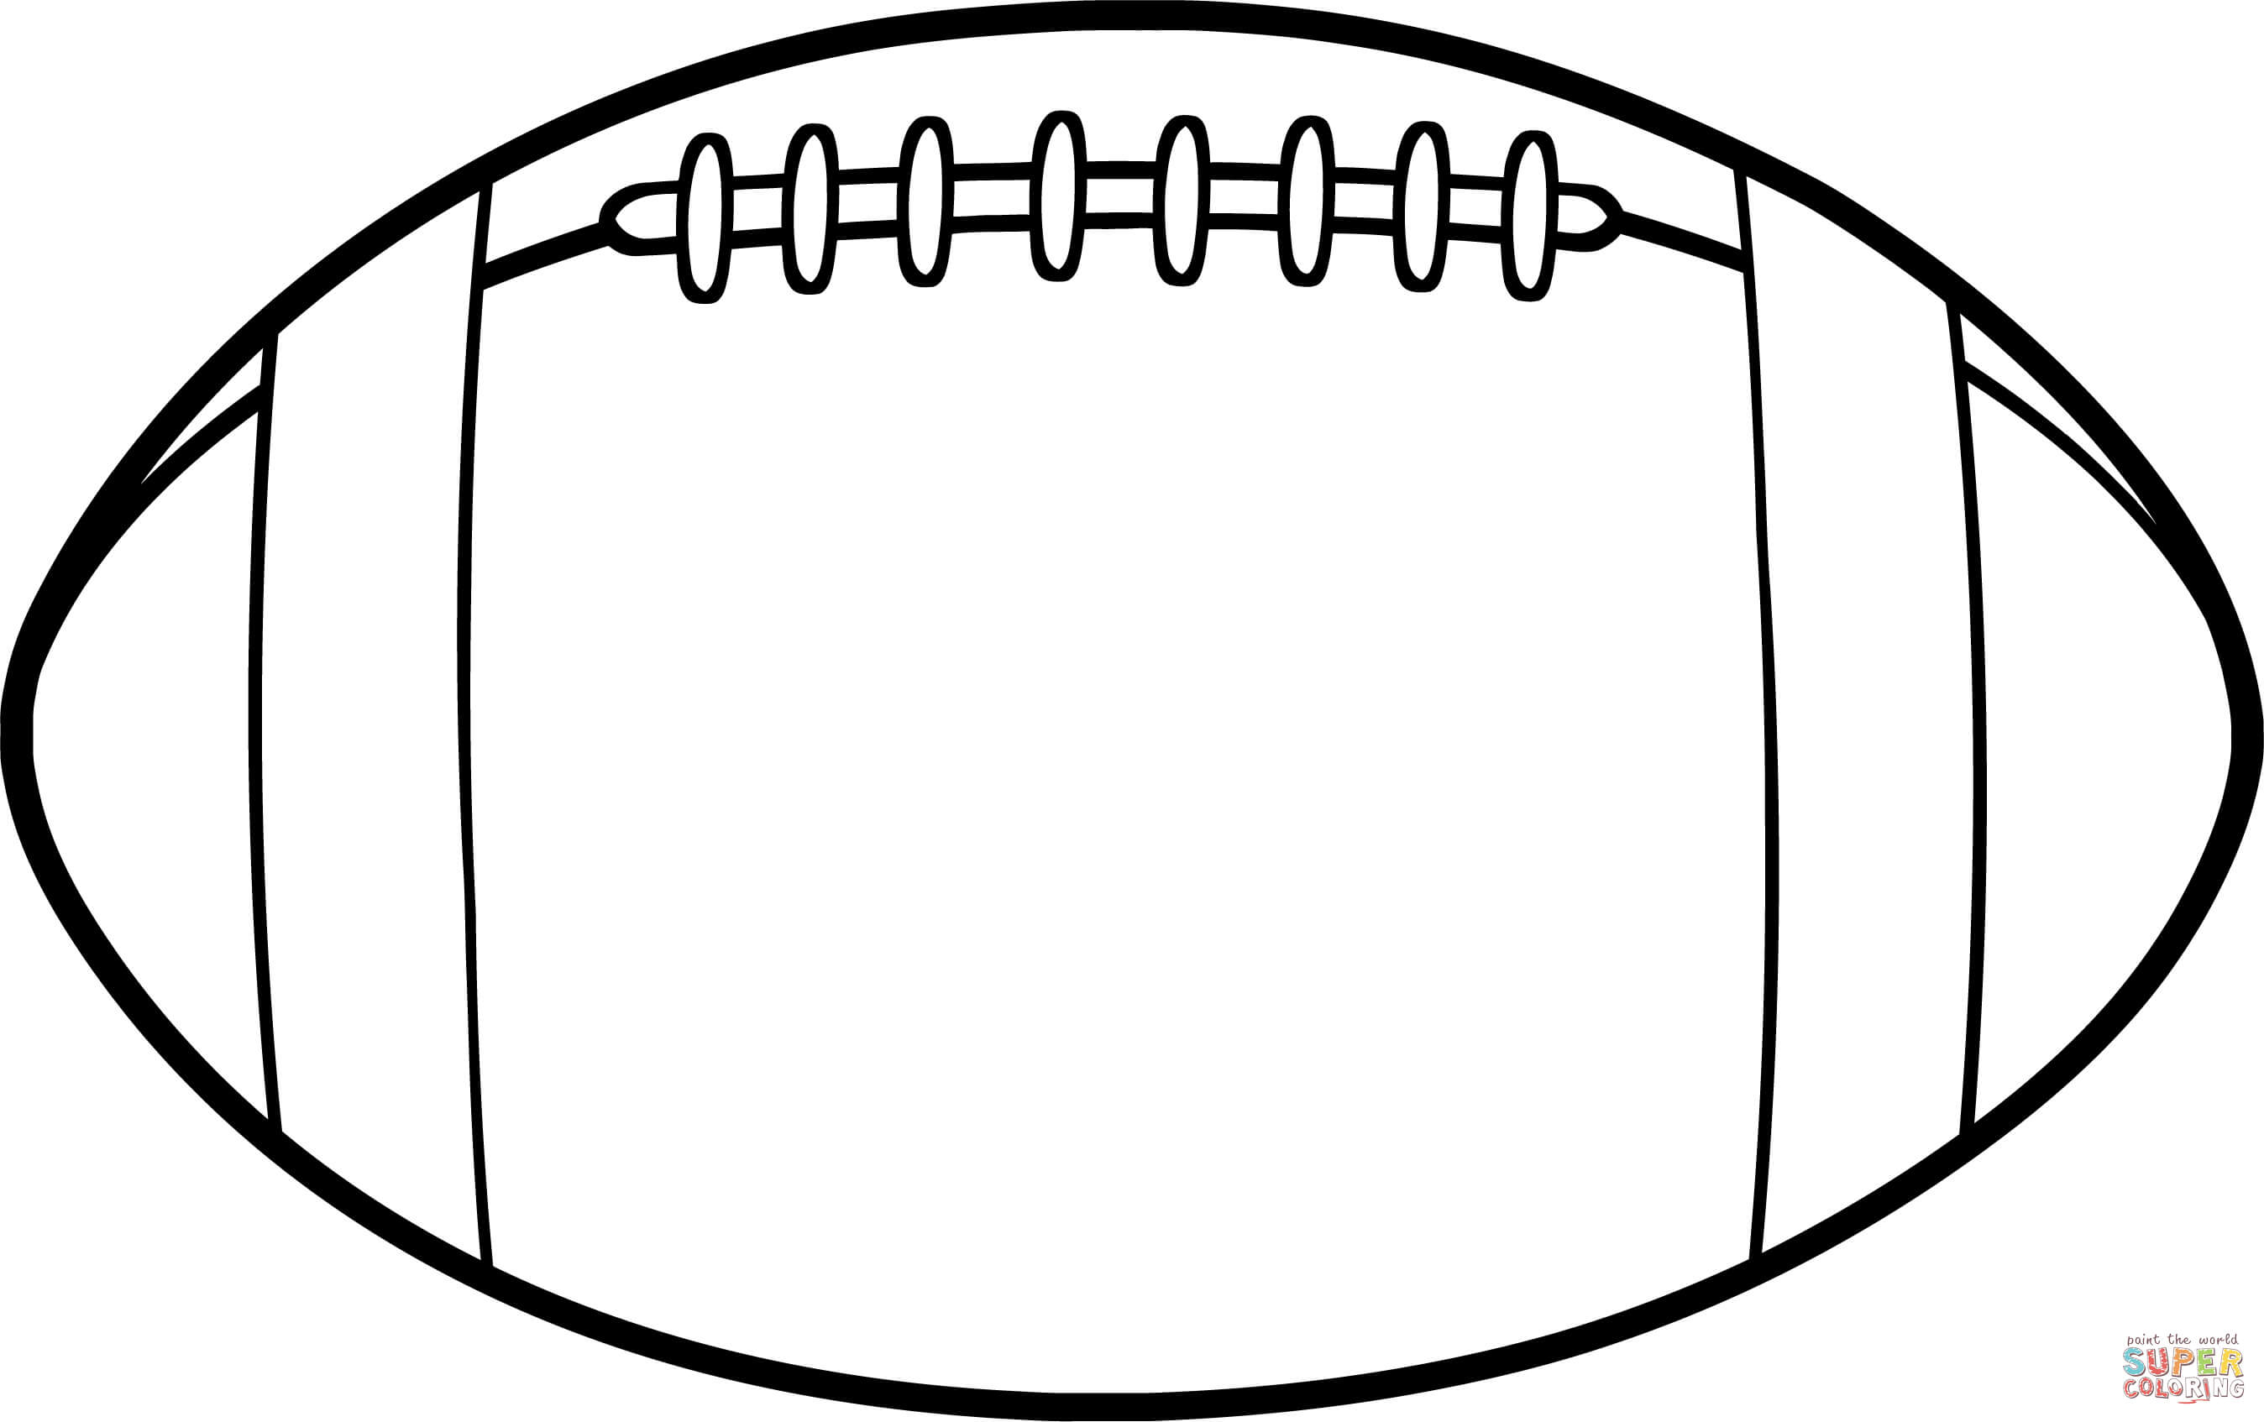
Questions?

